Slide 1
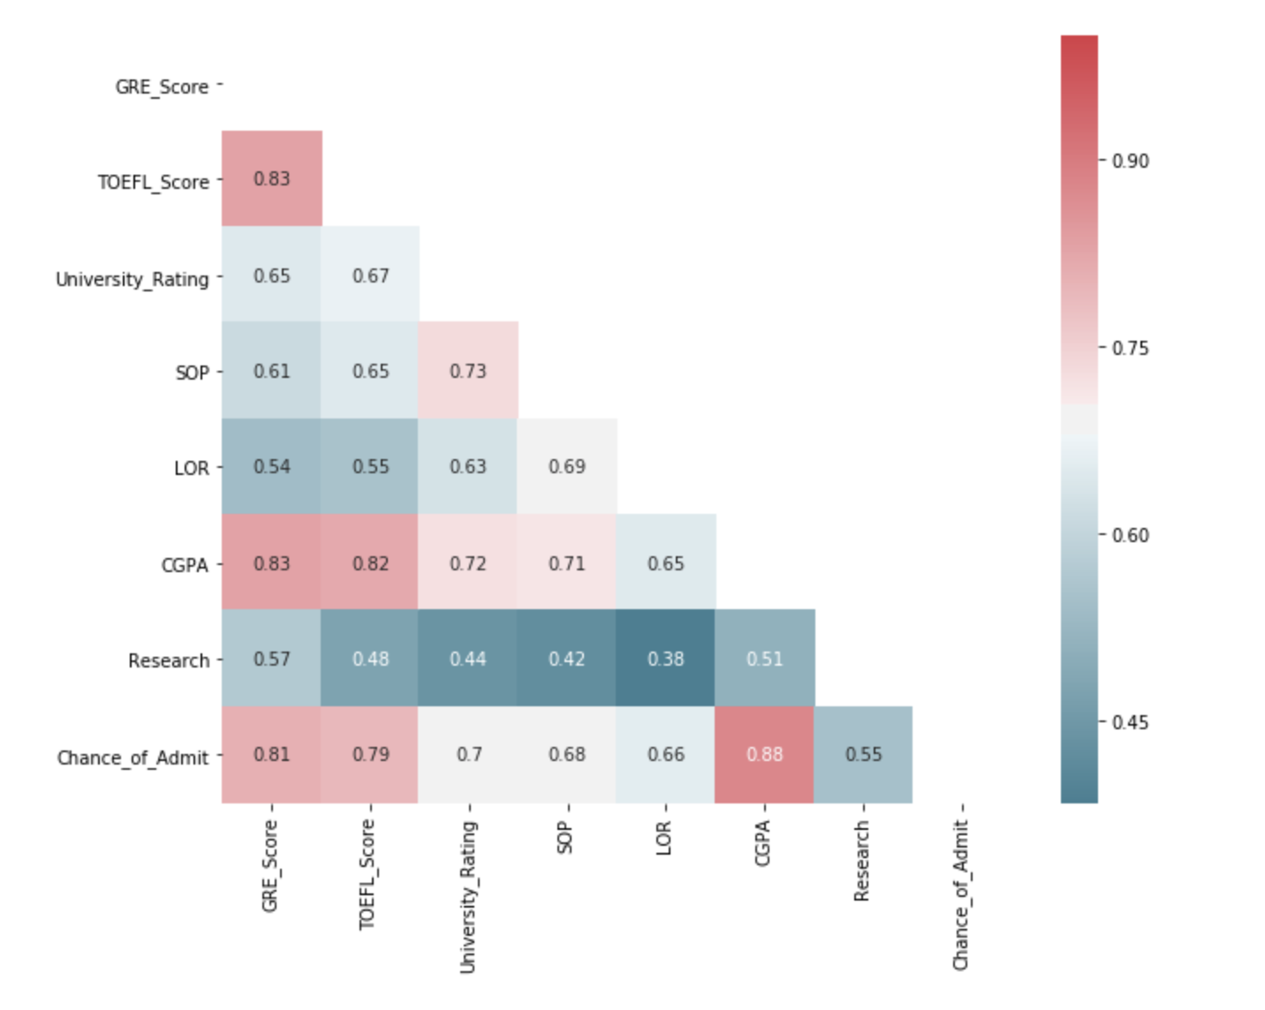
co
Introduction
This project mainly focuses on what parameters are important for a student to get into UCLA graduate school, and how these factors are interrelated among themselves. It will also help predict candidates' chances of admission given the variables.
Correlations between different columns
The 3 most important features for admission to the Master: CGPA, GRE SCORE, and TOEFL SCORE
The 3 least important features for admission to the Master: Research, LOR, and SOP

Slide 2
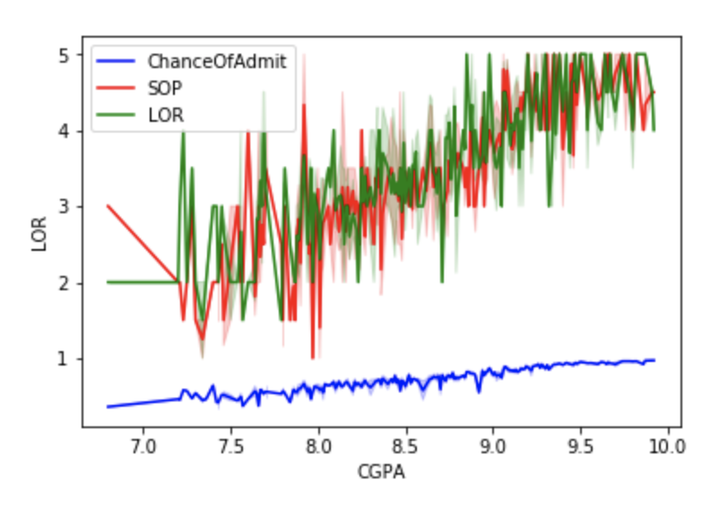
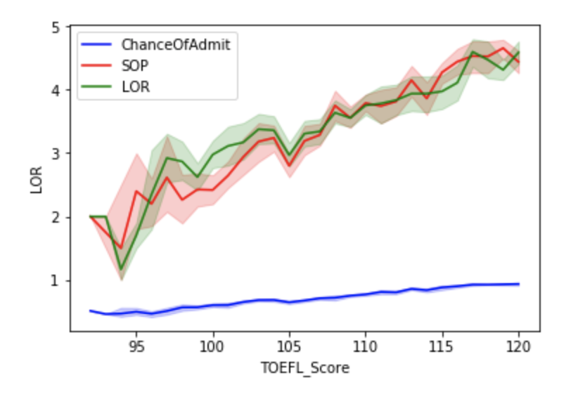
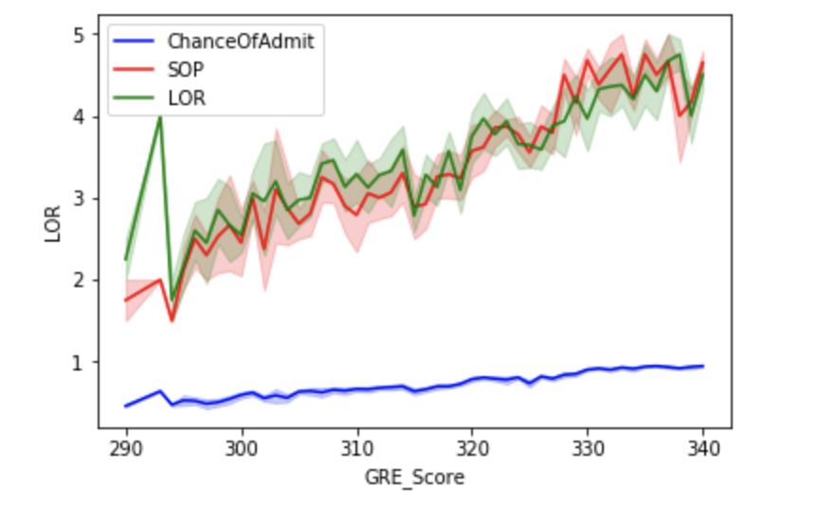
CGPA, GRE Score, TOEFL Score

Slide 3
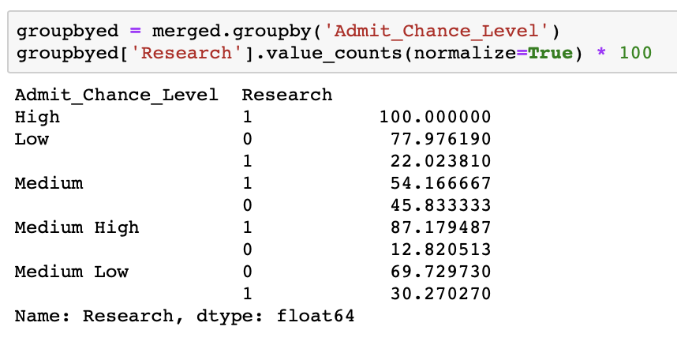
How important is research?
As GRE score, TOEFL score, and CGPA get higher, students have higher chance to get admission. Also, students with higher admission rate usually have research experience. On the vice versa, students with research experience have good GRE scores and TOEFL scores.

Slide 4
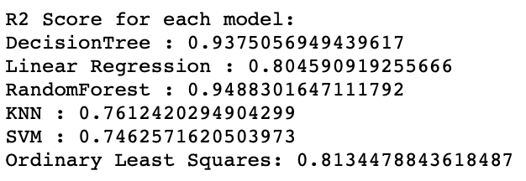
By compared R2 of different models, the best model is Random Forest which has the highest R2 score ( 0.95)

Slide 5
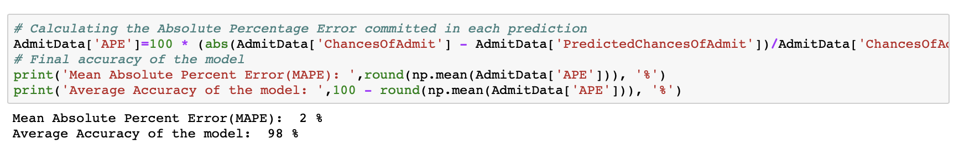
Feature Importance based on Random Forest Model
The most important parameter is CGPA The model is 98% accurate to predict admission status of a candidate

